Slide 1

Unbiased Multiple Instance Learning for Weakly Supervised Video Anomaly Detection
Paper review
Gibeom Kim (UST)

Slide 2
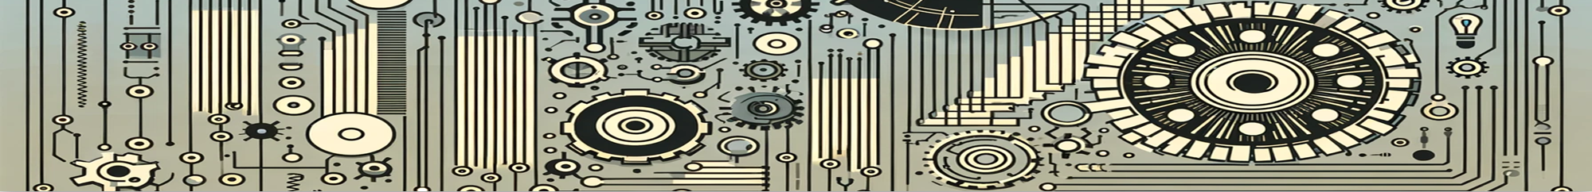
Index
Paper abstract
1-1. Multiple Instance Learning (MIL)
Model
Conclusion

Slide 3
1. Paper abstract
UMIL introduces an unbiased learning approach to solve the context bias issue in traditional MIL.
The dataset is divided into two dataset: a confident set and an ambiguous set.
Also ambiguous set is clustered into two dataset.
During training, similar datasets are trained to produce similar outputs, while different snippets yield different outputs.

Slide 4
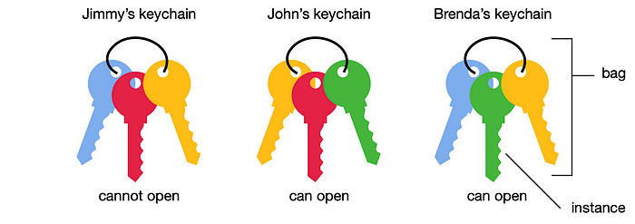
1-1. Multiple Instance Learning (MIL)
A type of weakly supervised learning algorithm
Training set consists of labeled "bags," each containing multiple instances.
A bag is typically labeled positive if at least one instance in it is positive, and negative if all instances are negative
Train a model that can predict the labels of unseen bags

Slide 5
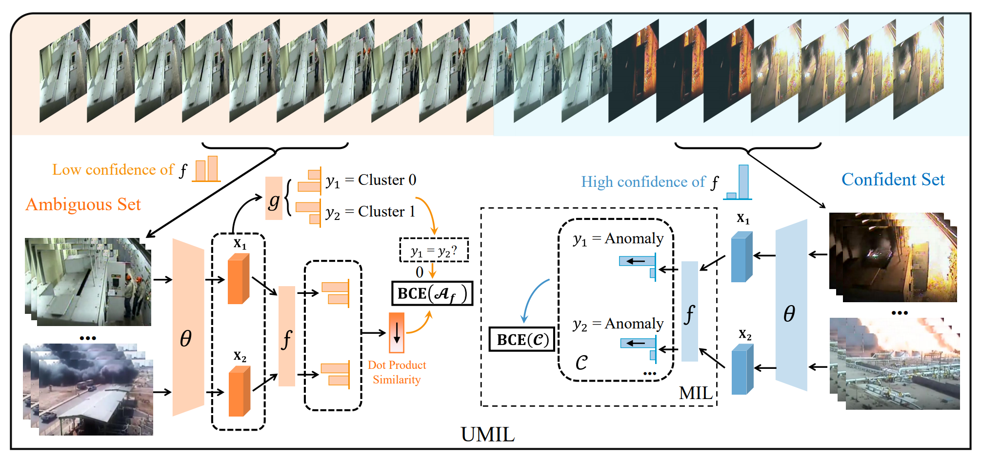
1. Paper Abstract

Slide 6
2. Model
Dataset preprocess
Make image data bags(=snippets) to train
Divide snippets to confidence set and ambiguous set by using anomaly head f

Slide 7
2. Model
Train with confidence set
Extract feature by using pretrained model(θ, e.g. X-CLIP)
Calculate the confidence of the snippets by using anomaly head
Update the model with binary cross entropy loss of confidence

Slide 8
2. Model
Train with ambiguous set
Divide snippets to two cluster by using cluster head g.
Extract feature by using pretrained model(θ, e.g. X-CLIP)
Calculate the confidence of the snippets by using anomaly head
Update the model with binary cross entropy loss of confidence
Notes:
데이터를 두개의 클러스터로 나누고 클러스터링 결과와 실제 레이블 간의 Binary Cross-Entropy를 계산
비디오 특징 벡터 간의 유사성을 기반으로 계산되며, 모델이 서로 유사한 비디오 특징을 유사한 방식으로 처리하도록 계산

Slide 9
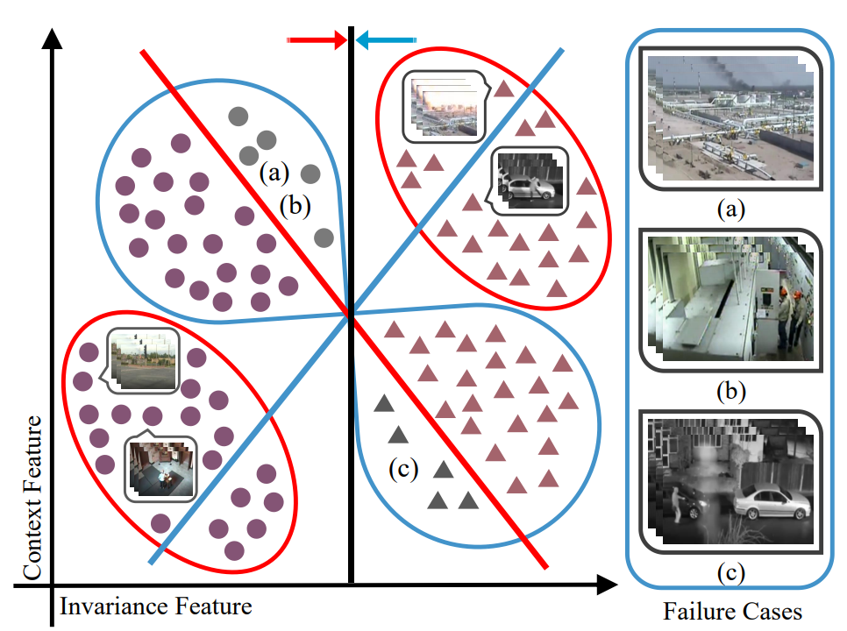
3. Conclusion
Red circle: Confident Set
Blue circle: Ambiguous Set
● : Normal sample
▲ : Abnormal sample
Gray instances : Failure cases
Red line : The classifier trained under MIL
Blue line : Ambiguous snippets clustering
Black line : The invariant classifier

Slide 10
3. Conclusion
Shows better result than current state-of-the-art methods on UCF-Crime and TAD
Models that improve on the biased approach of learning only normal/non-normal snippets
Remove context bias by separating unsupervised clusters from ambiguous snippets
The method of unsupervised clusters in ambiguous snippets might be used for various tasks.

Slide 11
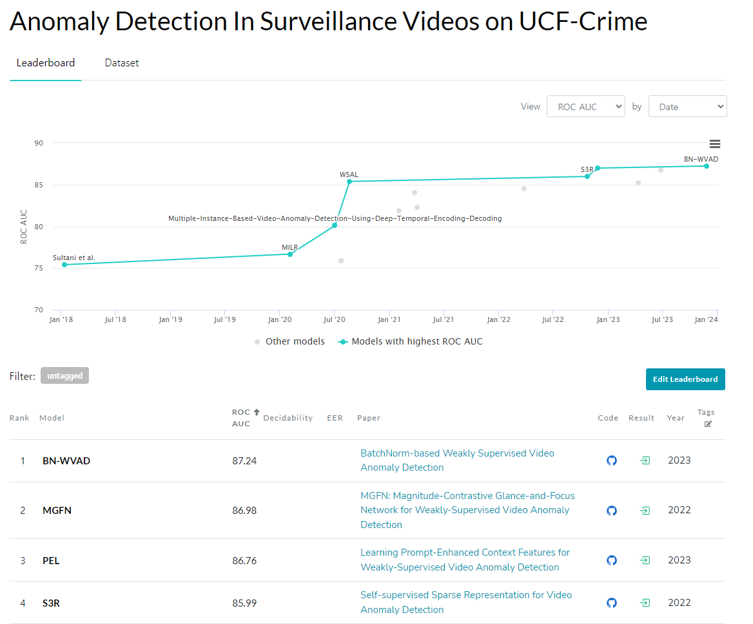
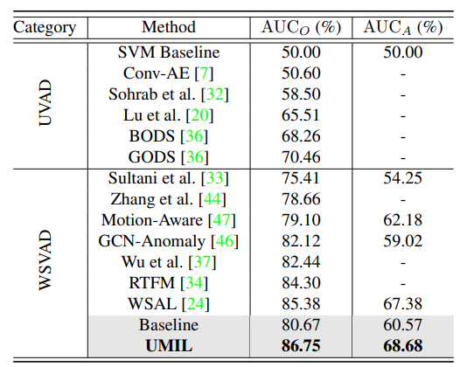
3. Conclusion

Slide 12
Thank you

